Slide 1
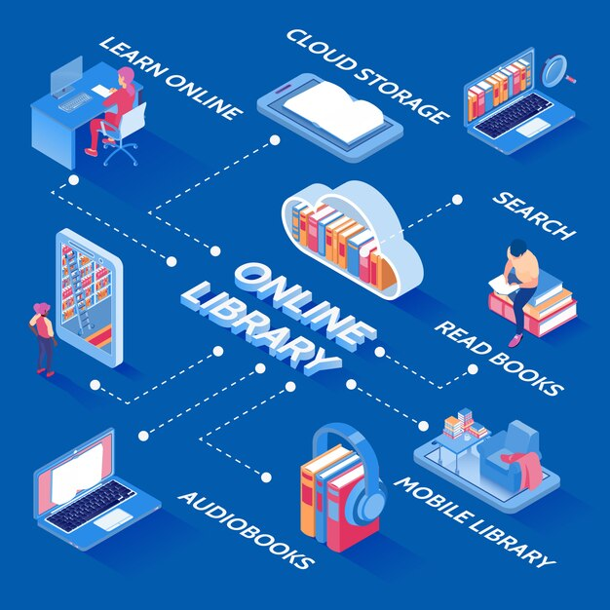
Library Management System (LMS)
Team Members:
Rohith Vankayalapati – Y00857057
Madhu Babu Yalavarthi – Y00859770
Kumar Teja Vellaturi – Y00854199

Slide 2
Overview
The Library Management System (LMS) project is a modern solution designed to streamline and automate various tasks involved in managing a library.
It aims to replace manual processes with an efficient digital system to enhance the overall management of library resources.

Slide 3
Importance of Efficient Library Management
Efficient library management is crucial for educational institutions to ensure smooth access to resources and effective academic support for students and faculty.
Manual processes are time-consuming, error-prone, and inefficient, leading to delays and inaccuracies in book management, student registration, and approval processes.
An automated LMS system can significantly improve the efficiency and accuracy of library operations, leading to better utilization of resources and enhanced user experience.

Slide 4

Key Features and Objectives
User Authentication
Librarian Dashboard
Book Entry Automation
Student Approval System
Book Issuance and Return

Slide 5
Traditional Library Management Processes
Libraries have traditionally relied on manual processes for tasks such as book cataloging, student registration, and book issuance.
These processes often involve paper-based records, manual data entry, and physical book tracking methods.

Slide 6
Challenges Faced Due to Manual Methods
Manual library management processes are time-consuming and labor-intensive.
They are prone to errors such as misplaced books, incorrect data entry, and lost records.
Retrieving information or managing large volumes of books can be cumbersome and inefficient.

Slide 7
Need for Automation and Digitization in Library Administration
In today's digital age, there is a growing need for automation and digitization in library administration.
Automated systems can streamline processes, reduce errors, and improve overall efficiency.
Digitization allows for easier access to information, better organization of resources, and enhanced user experience.

Slide 8
Identification of Time-Consuming and Error-Prone Manual Processes
Manual library management processes, such as book cataloging, student registration, and book issuance, are time-consuming and prone to errors.
Challenges include manual data entry, difficulty in tracking borrowed books, and maintaining accurate records.

Slide 9
Explanation of How the LMS Project Aims to Solve These Challenges
The LMS project aims to automate and streamline library management processes, reducing manual intervention and minimizing errors.
Features such as automated book entry, student registration system, and digital book tracking facilitate efficient management of library resources.

Slide 10
Benefits of Implementing an Automated Library Management System
Increased efficiency: Streamlined processes save time and effort for librarians and users.
Reduced errors: Automation minimizes the risk of manual data entry errors and lost records.
Improved user experience: Digital interfaces and easy access to information enhance the overall user experience.
Better resource utilization: Real-time tracking of books and student records enables optimal resource management.

Slide 11
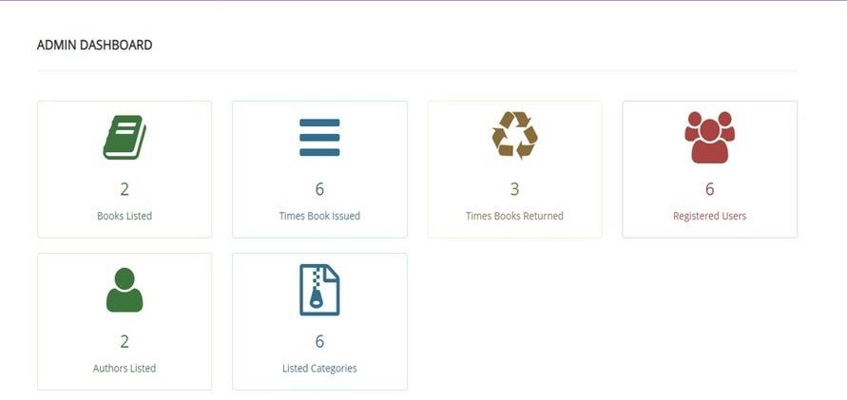
Admin Dashboard
The admin dashboard displays options such as listed books, authors, registered students, and times books issued, providing administrators with access to key library management functionalities.

Slide 12
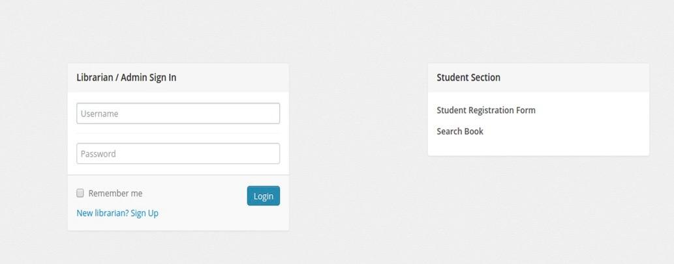
Admin Login Page
The admin login page features fields for entering username and password, along with a login button. Additionally, it provides links for student registration and searching books, offering easy access to essential features.

Slide 13
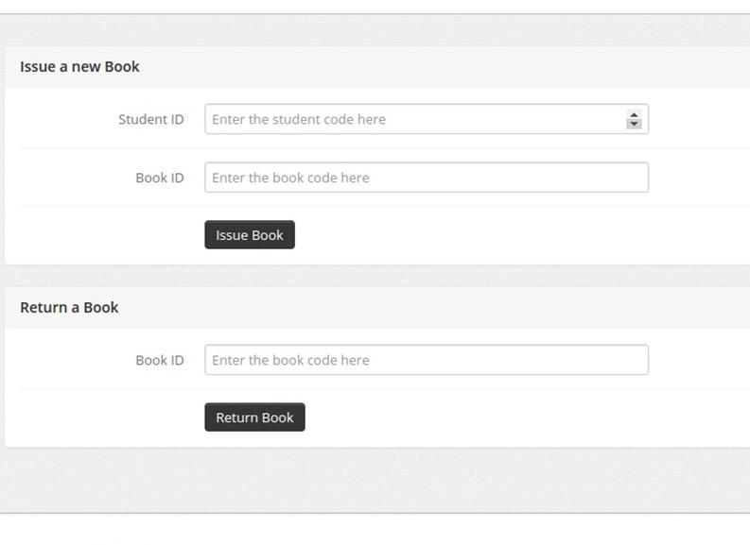
Book Issue Page
The book issue page includes fields for entering student ID and book ID, as well as an option to return a book by entering the book ID. This form facilitates the process of issuing and returning books, contributing to efficient library management.

Slide 14
Conclusion
Automated library management systems, such as the Library Management System (LMS) project, play a crucial role in streamlining and enhancing library administration.
Throughout the presentation, we discussed the challenges of traditional manual processes and the benefits of implementing automated solutions.
The LMS project offers features such as user authentication, book entry automation, and student approval system to address these challenges and improve efficiency.

Slide 15
Future Prospects and Enhancements
The LMS project has promising future prospects for integration with additional features or technologies to further enhance its functionality.
Potential enhancements may include integration with RFID technology for book tracking, implementation of data analytics for insights into library usage patterns, and integration with digital lending platforms for expanded access to e-books and online resources.

Slide 16
THANK YOU!

